Slide 1
Framework structure
Test layer: @Test 1 @Test 2 @Test 3
doAction() doAction() doAction()
assert() assert() assert()
Business layer
PageObject
Models
Core layer
Service
Data layer
Browser/Browser Factory
API (preconditions)
Resources (property/xml files)
Utils/Helpers
Enums
MailService (in progress)
Data/StringRandom Utils
PropertyReader
Cryptor, TestListener

Slide 2
API service
Preconditions for UI tests
Data and tools for requests
1. Create an empty repository
2. Delete a repository
3. Create a project in a repository
4. Create an issue in a repository
1. Base API url : https://api.github.com
2. API endpoints (e.g. /user/repos)
3. User authentication (login, password) 4. Models (Issue, Project, Repository)
5. Jackson, REST Assured library

Slide 3
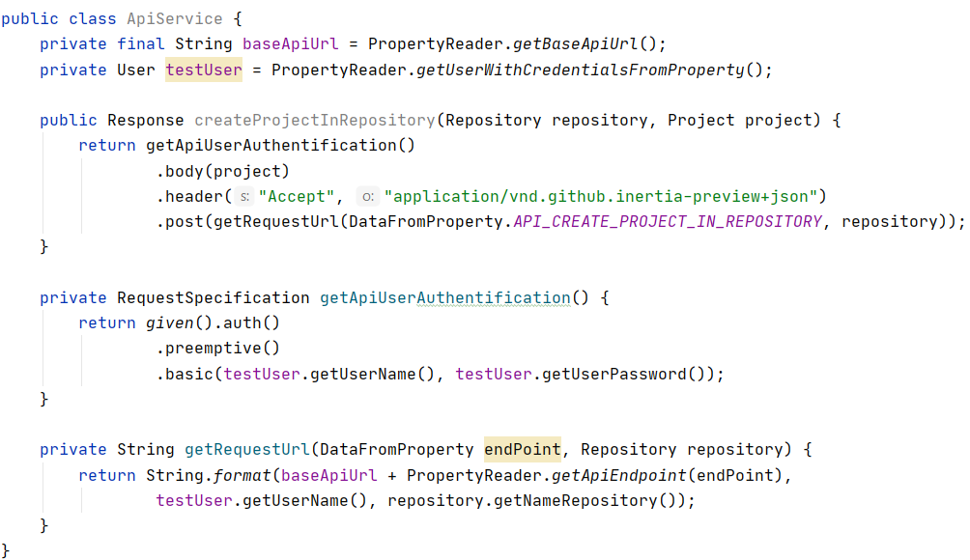

Code structure
Read from property file
Object in JSON

